Slide 1
Predicting Honey Production with Bioclimatic Variables
Joseph Scavetta

Slide 2
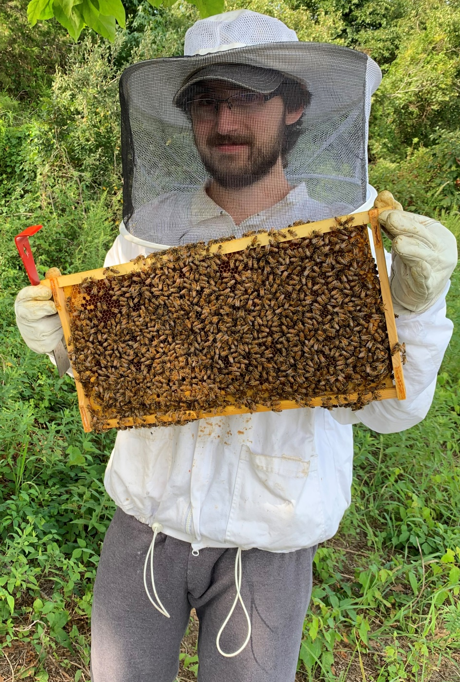
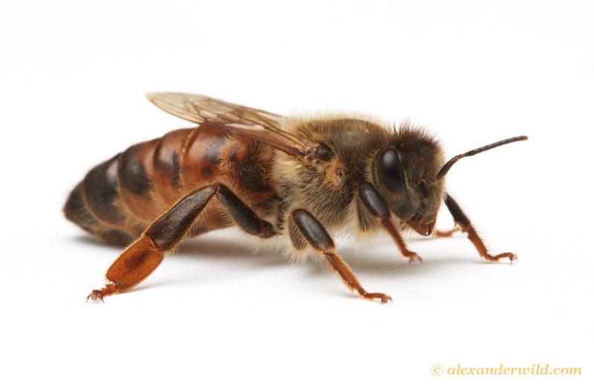
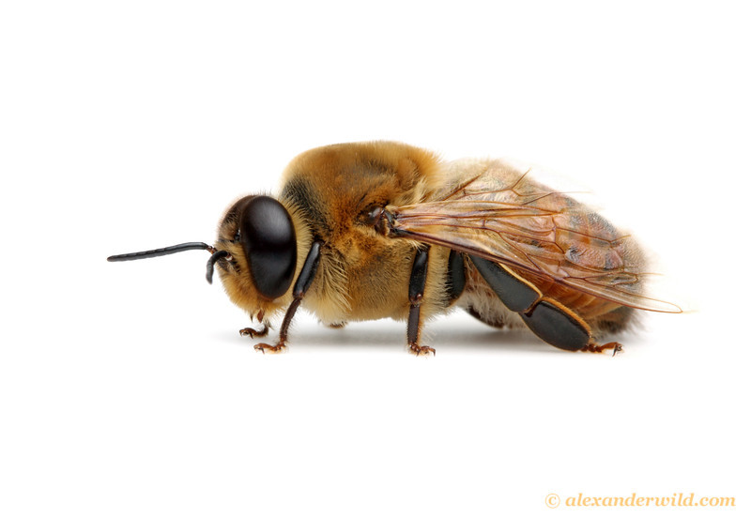
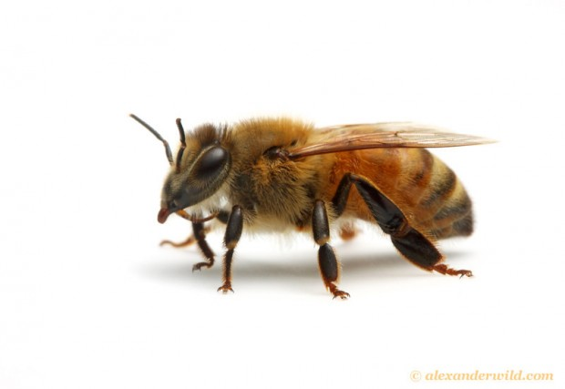
The Honey Bee
Used for many purposes in the agricultural industry
Pollination
∼75% of important crops depend to some degree on pollination
Pollination adds ∼9% to the global crop production
Wax production
Honey production
In 2017 global production of honey was about 2 million tons
Apis mellifera Queen
Apis mellifera Drone
Apis mellifera Worker

Slide 3
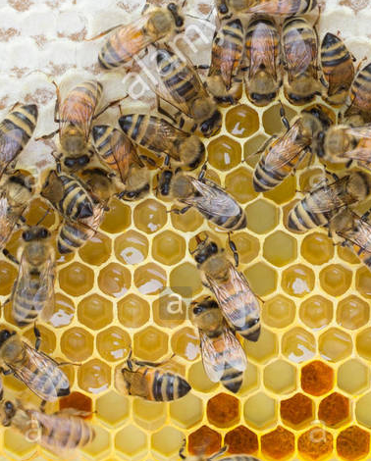
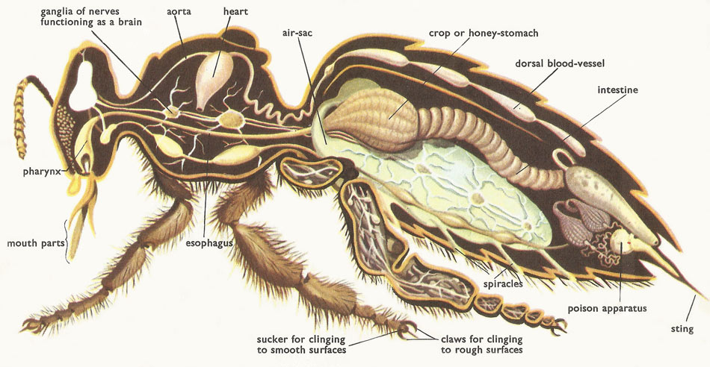
How is Honey Produced?
Capped Honey
Honey bees produce honey from the nectar they collect from flowers
Nectar is initially stored and processed within their crop
In the hive, honey is stored in wax cells
Bees will fan the honey to remove moisture until capping the cell for long term storage
Raw Honey
Pollen

Slide 4
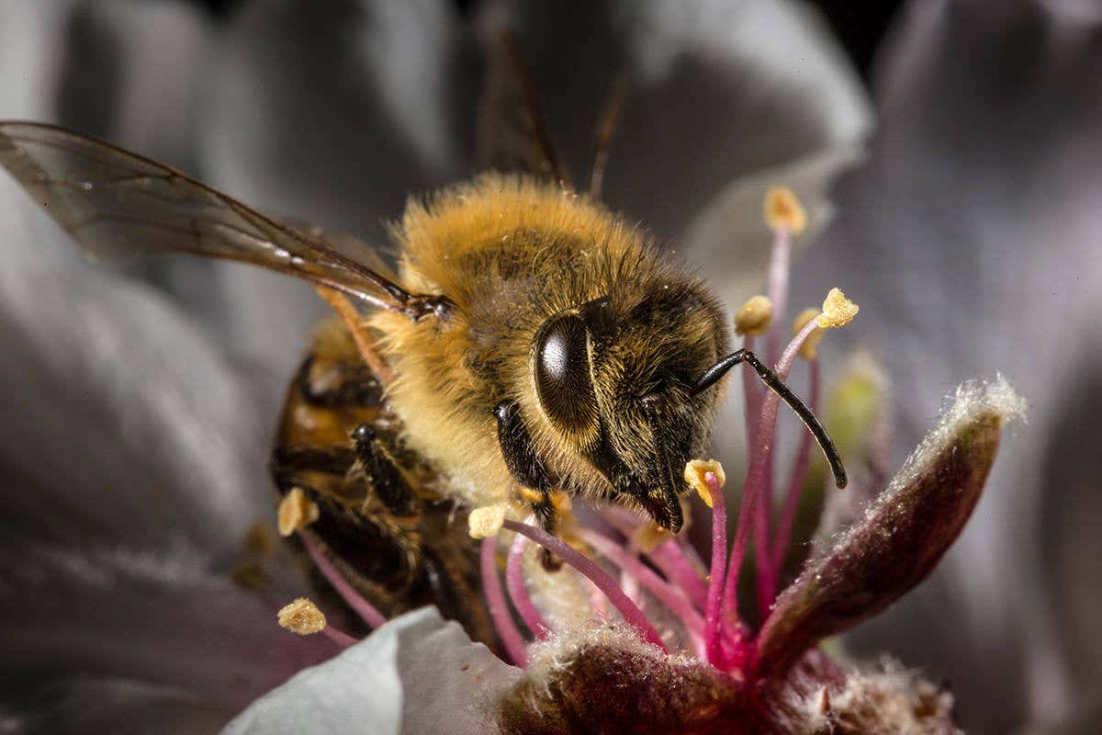
Could Climate Impact Honey Production?
The overall process of honey production is reliant on many complicated steps, all of which could be affected by differing climate conditions
The flowering plants that produce the nectar
The overall colony strength
Amount of time allotted to forage
Ability to process nectar in hive
Human impact

Slide 5
USDA Data
I am using 2017’s annual census conducted by the United Stated Department of Agriculture (USDA)
Includes county level data for honey production, number of colonies, and agricultural land usage
For additional data, I am using a 2017 survey which has state level data on the percent of colonies affected by different diseases.
state | county | honey_per_colony | agricultural_other | cropland | cropland_harvested | cropland_pastured | pastureland | woodland | woodland_pastured | agricultural_total | affected_disease | affected_pesticides | affected_pests | affected_varroa
1 | 1 | 53.5036 | 2.22633 | 2.31727 | 7.24332 | 0.135893 | 6.11255 | 10.4007 | 1.32791 | 29.7639 | 0.2 | 3.2 | 9.8 | 19.9
1 | 101 | 12 | 3.7389 | 1.81911 | 7.63659 | 1.87701 | 19.4658 | 9.48177 | 2.35318 | 46.3723 | 0.2 | 3.2 | 9.8 | 19.9
1 | 105 | 12.8571 | 3.77071 | 1.39586 | 6.88464 | 0.671116 | 7.48476 | 13.6301 | 1.60191 | 35.4391 | 0.2 | 3.2 | 9.8 | 19.9
1 | 107 | 56.1538 | 1.03986 | 1.27899 | 3.44504 | 0.0829618 | 4.02294 | 8.02992 | 0.684435 | 18.5842 | 0.2 | 3.2 | 9.8 | 19.9
1 | 109 | 33.915 | 3.3216 | 1.64604 | 6.59693 | 1.19407 | 7.59665 | 14.9827 | 3.18164 | 38.5196 | 0.2 | 3.2 | 9.8 | 19.9

Slide 6
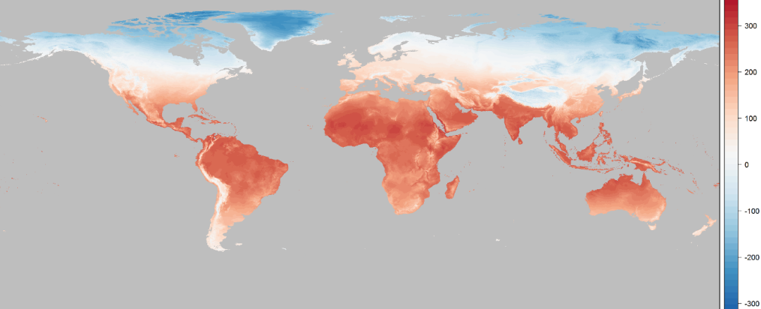
Bioclim Data
For climate data, I am using geographic raster data supplied by Worldclim, specifically, bioclimatic variables
Intended to be conditions that may be meaningful to biological species
Annual Mean Temperature
Temperature Seasonality
Max Temperature of the Warmest Month

Slide 7
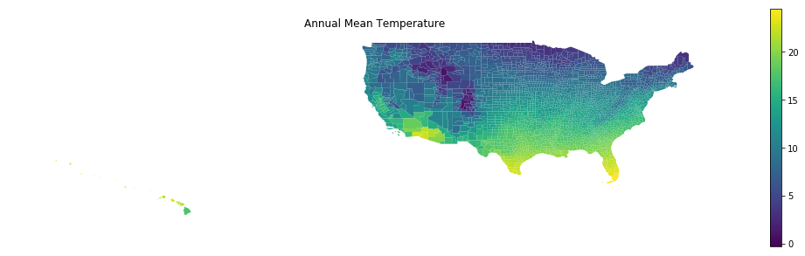
Geographic Information System (GIS)
Raster files have precise detail down to some geographic pixel size
Using a shapefile provided by the U.S. Census Bureau’s I can calculate mean values for each environmental condition for each county
mean_temp_warmest_quarter | mean_temp_coldest_quarter | annual_precip | precip_wettest_month | precip_driest_month | precip_seasonality | precip_wettest_quarter | precip_driest_quarter | precip_warmest_quarter | precip_coldest_quarter
26.272444 | 8.521516 | 1396.000000 | 166.642857 | 71.988095 | 21.044067 | 434.202381 | 274.309524 | 328.345238 | 398.654762
26.596718 | 9.265874 | 1381.267241 | 168.250000 | 66.905172 | 21.544102 | 430.353448 | 266.163793 | 336.482759 | 387.612069
26.229264 | 8.133950 | 1410.735849 | 161.179245 | 75.641509 | 20.282454 | 440.547170 | 272.216981 | 327.518868 | 410.047170
26.000874 | 7.087960 | 1448.242424 | 162.689394 | 82.500000 | 20.497546 | 439.151515 | 269.795455 | 322.787879 | 415.136364
26.243121 | 9.336603 | 1373.457447 | 165.542553 | 72.946809 | 20.706376 | 420.053191 | 267.457447 | 356.723404 | 372.851064

Slide 8
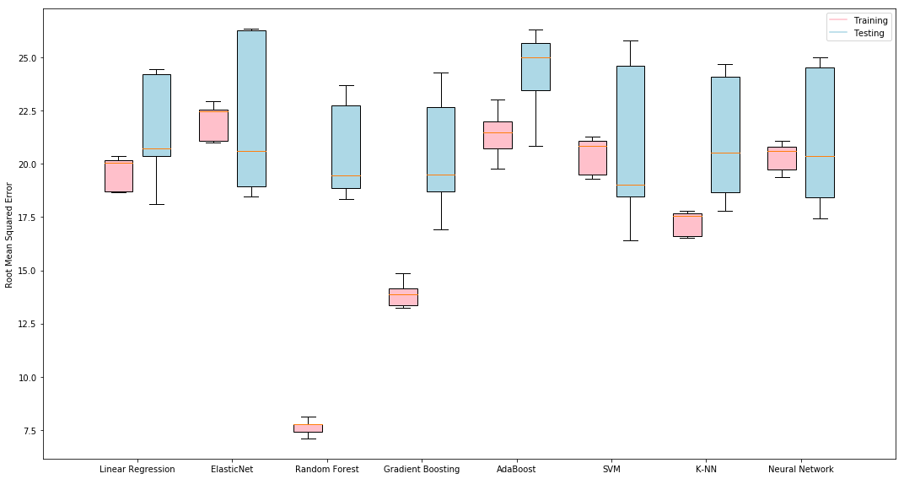
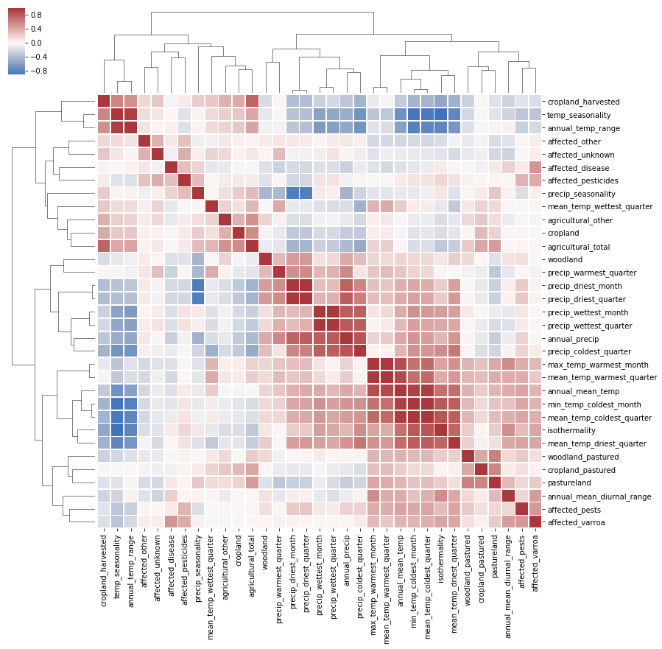
Full Dataset
Random Forest
Max Features = 9.1%
Number of Estimators = 899
RMSE: 20.01 ± 2.65

Slide 9
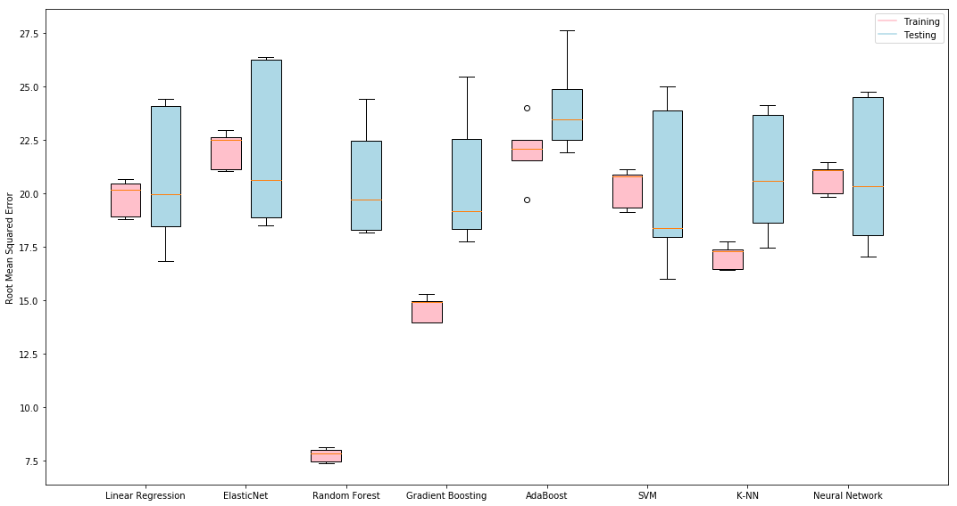
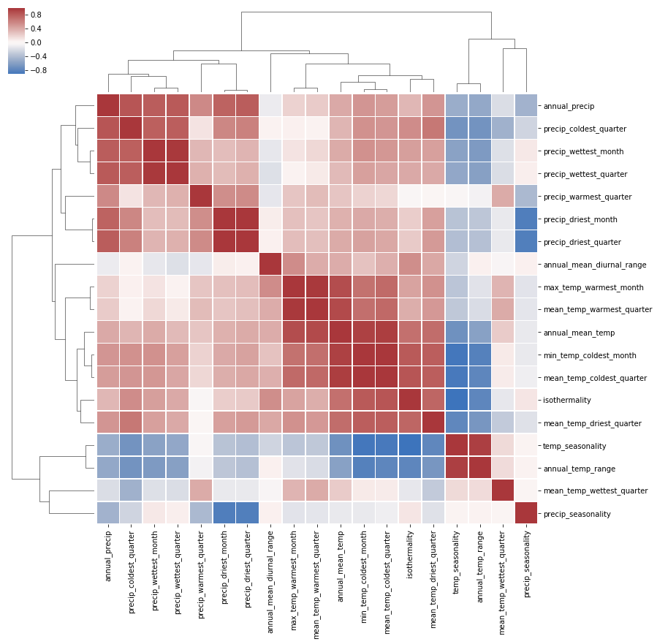
Climate Variables
Random Forest
Max Features = 9.8%
Number of Estimators = 1822
RMSE: 19.88 ± 2.82

Slide 10
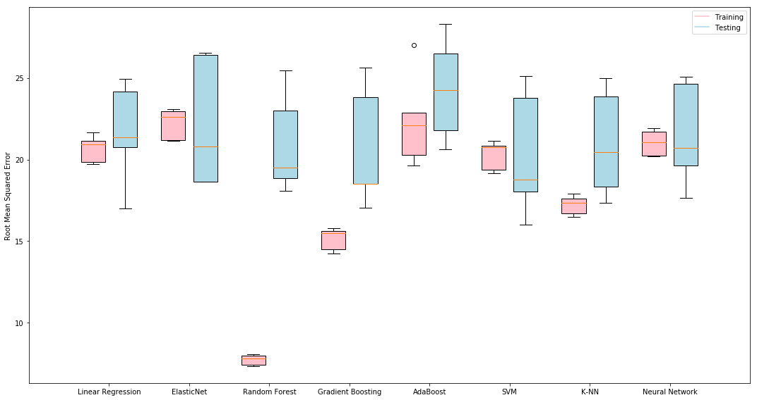
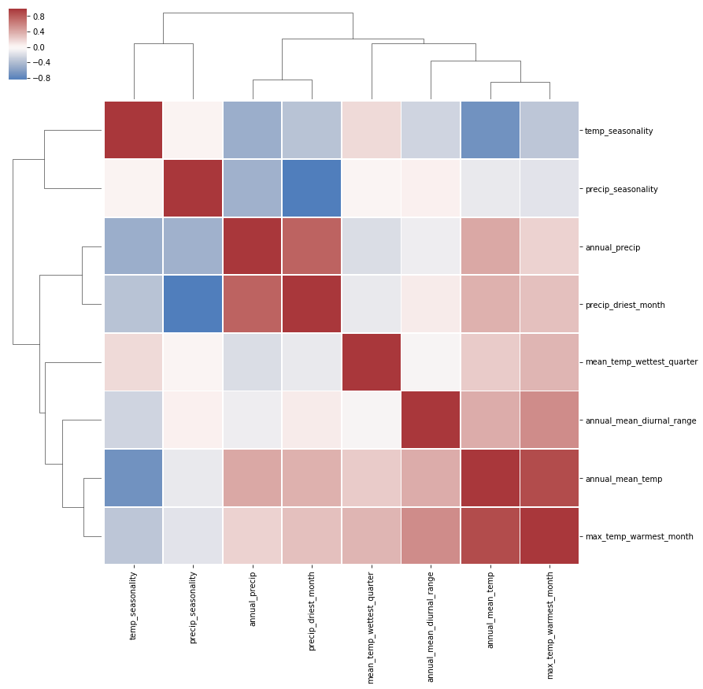
Climate Variables
Random Forest
Max Features = 14.3%
Number of Estimators = 1923
RMSE: 20.08 ± 2.90

Slide 11
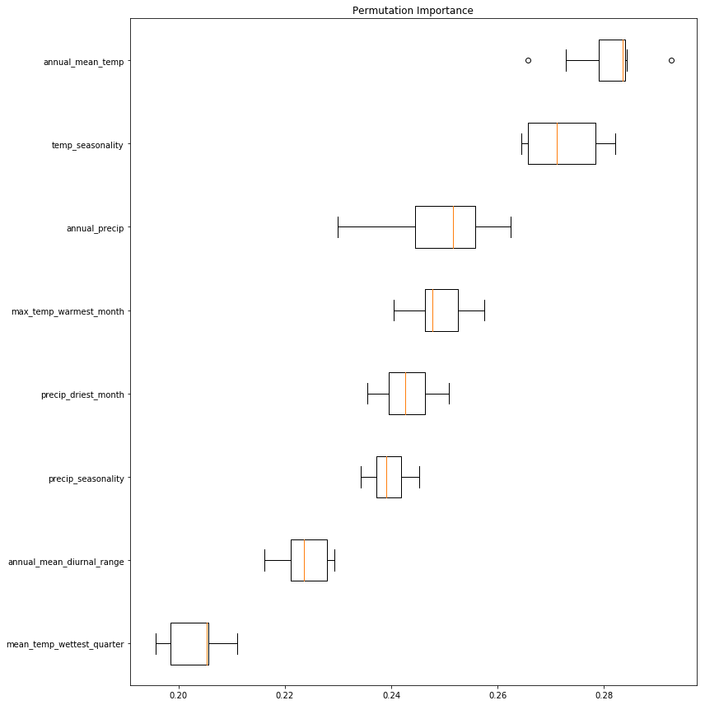
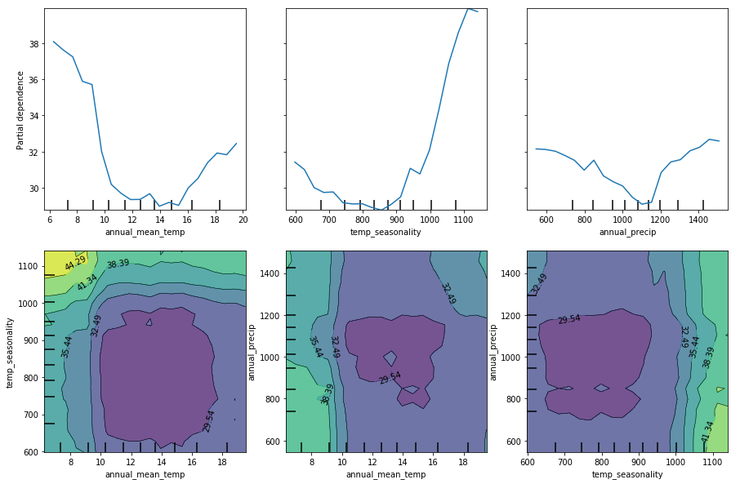
Feature Importance

Slide 12
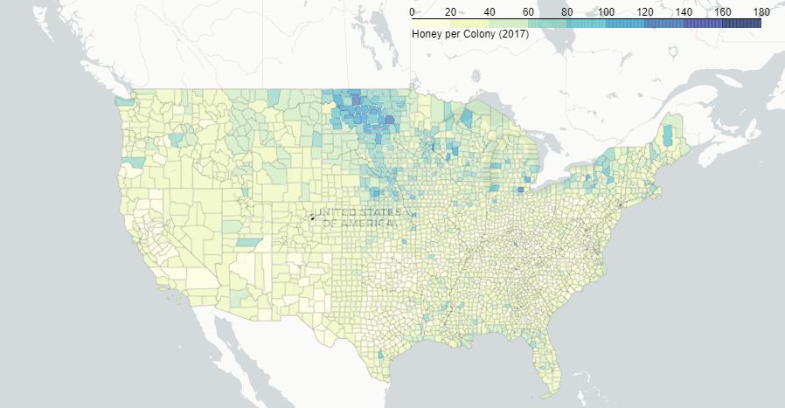
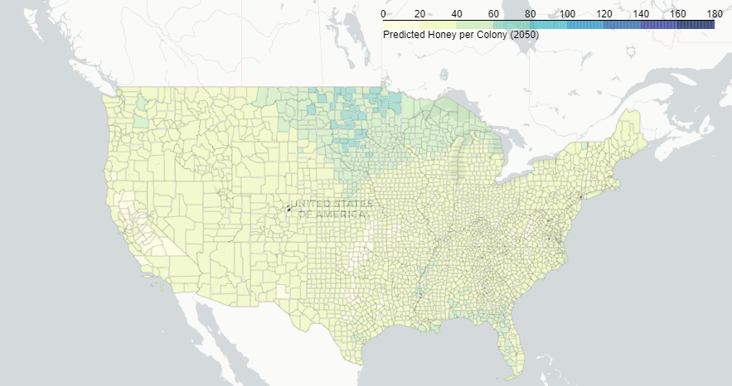
Predicting Future Honey Production
I can now use projected climate data for the year 2050 given a Representative Concentration Pathway (RCP)
I am using RCP 4.5; emissions in RCP 4.5 peak around 2040, then decline
Using Climate Data from 2017
Using Climate Data Projected for 2050

Slide 13
Unsolicited Fact Checking if you’re Interested
Honey bee pollination is essential for human food production!
Not true.
Though many crops do benefit from insect pollination, many can self-pollinate or pollinate through wind
More than 20,000 species of bees (many are solitary) as well as butterflies, flies, and many species of vertebrates pollinate plants
Yea but Einstein said “If bees disappeared off the face of the earth, man would only have four years left to live.”
There is no documented case of him having said this, even if he did, it is false
Okay, but still, Honey bees are becoming endangered so they are still an ecological issue!
Also not true, especially in the United States
Honey bees are technically an invasive species here (hence European Honey Bee)
They tend to outcompete many of the wild native pollinators (bumble bees for example), many of which are becoming nationally or globally threatened
Oh, so honey bees are evil and we should get rid of them?
No, they are just doing what they are good at, we just need to be more cautious in how we manage them agriculturally and realize that the mass media hype should be focused towards native bee species rather than honey bees
Also, they are one of the only sources of honey, and I think a lot of us like honey
Geldmann, Jonas, and Juan P. González-Varo. "Conserving Honey Bees Does Not Help Wildlife". Science, vol 359, no. 6374, 2018, pp. 392-393. American Assoiation For The Advancement Of Science (AAAS), doi:10.1126/science.aar2269.

Slide 14
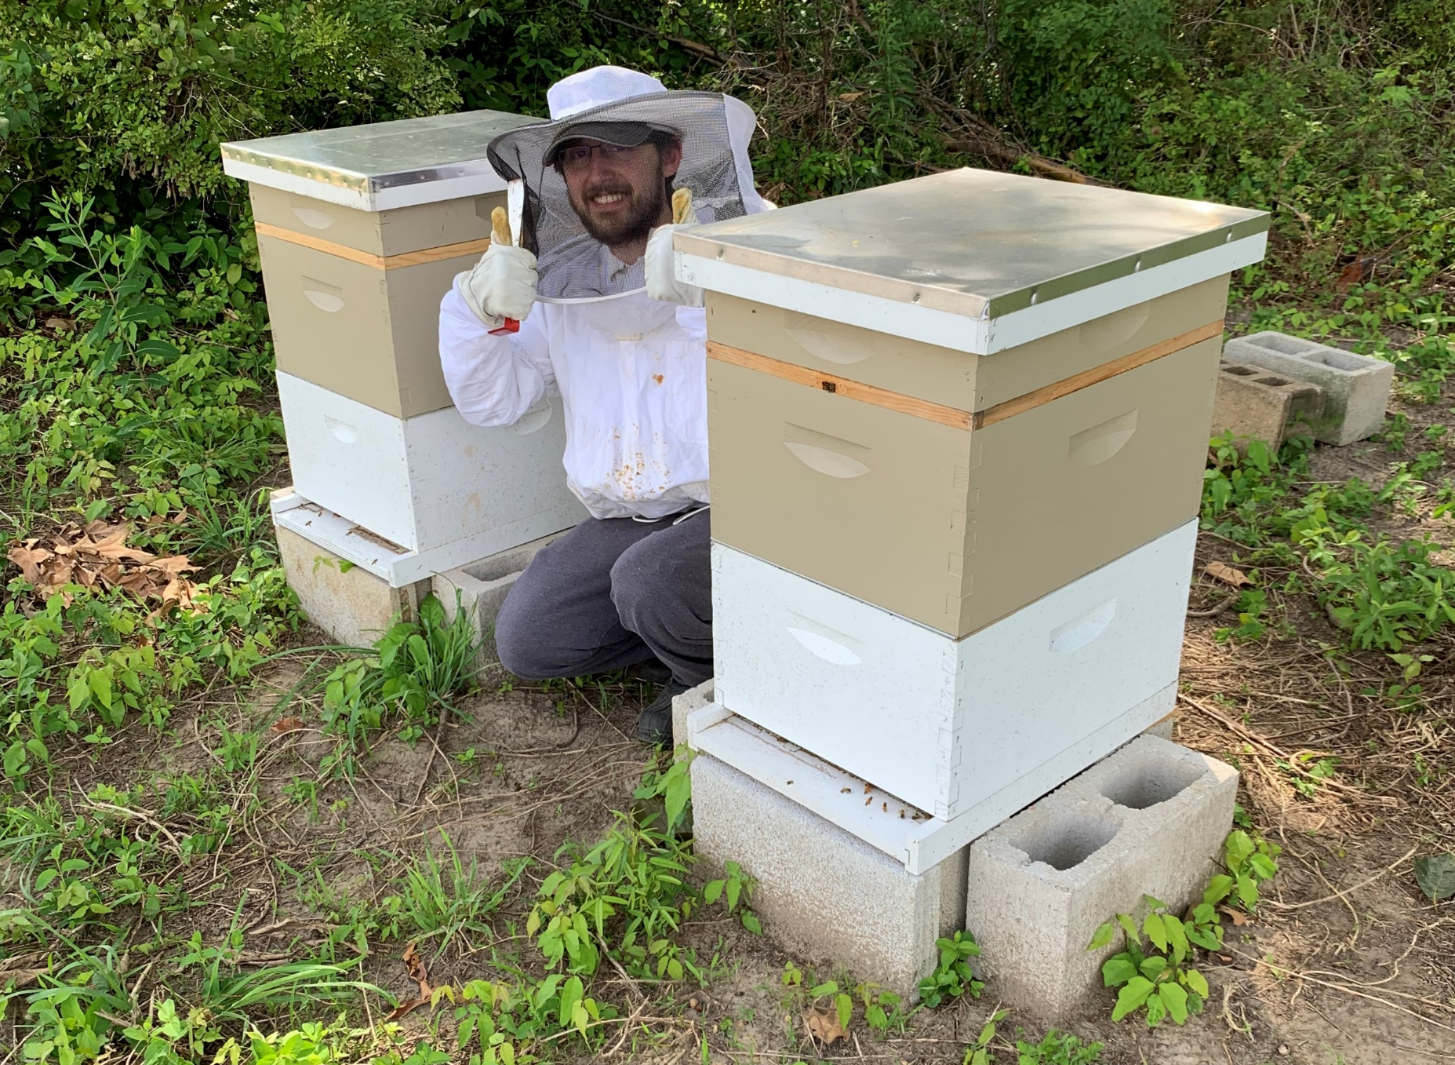
Data and Source Code Available on Github
https://github.com/jscavetta95/honey-production-models

